Slide 1
MVP to MVVM
An Introduction to
Model-View-ViewModel
http://github.com/arcresources/MVPtoMVVM
Jason Lepp
Mo Khan
Craig Anderson
Notes:
Jason

Slide 2
Outline
Reviewing Model-View-Presenter
Sample App
Introduction to Model-View-ViewModel
What is it? Why use it?
DataContext/Binding
Communicating Changes to the View
User Interaction
Summary
Pros
Cons
Questions
Notes:
Jason
Next -> Mo

Slide 3
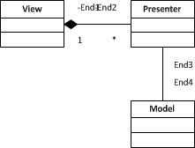
Reviewing Model-View-Presenter
Two Flavours
Supervising Controller
Passive View
There is a lot of chatter back and forth between the View and Presenter
Presenter has a reference to the View to tell it what to do
Presenter interacts with the Model to complete behaviours
Notes:
Jason
Ask audience about what they use? Winforms? Presentation patterns?
MVP -> Supervising Controller: “Factor the UI into a view and controller where the view handles simple mapping to the underlying model and the controller handles input response and complex view logic.”
MVP -> Passive View: “A screen and components with all application specific behavior extracted into a controller so that the widgets have their state controlled entirely by controller.”
Describe the actors View -> Presenter -> Model
Next -> overview of the app

Slide 4
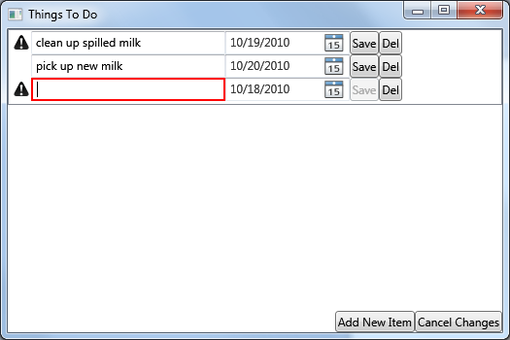
Things To Do – Sample App
Notes:
Jason
Overview of application.
Add/remove item
Validation
Notifications
Next -> Show the MVP code.

Slide 5
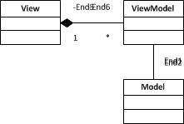
Introduction to Model-View-ViewModel
Another Presentation Pattern
ViewModel knows nothing of the View
ViewModel is attached to the View
Behaviour is executed through commands which interact with the Model
Notes:
Mo
MVVM: is a specialization of the more general Presentation Model pattern, tailor made for WPF and Silverlight.
View knows which properties it must bind to.
ViewModel communicates updates to the View via events.

Slide 6
Why Use Model-View-ViewModel?
Built-in plumbing via WPF features
Less Code
Looser Coupling
Focus on design without affecting behaviour
Maintainability
Simplicity
Notes:
Mo

Slide 7
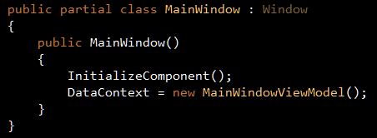
DataContext
DataContext
Every control has one
It is the ViewModel that is being bound to
Notes:
Mo
Code Example
Show the MainWindow.xaml.cs where we assign a ViewModel to the DataContext.
Show the MainWindow.xaml where we bind to properties on the target ViewModel.
Show the MainWindowViewModel to show the properties that the view is bound to.
Binding changes from the View to the View Model.
Next -> we will show you how to sync ViewModel to View changes.
-> CRAIG

Slide 8

Binding
Binding
Used to bind properties on a control to properties on a DataContext (ViewModel)
Notes:
Mo
Code Example
Show the MainWindow.xaml.cs where we assign a ViewModel to the DataContext.
Show the MainWindow.xaml where we bind to properties on the target ViewModel.
Show the MainWindowViewModel to show the properties that the view is bound to.
Binding changes from the View to the View Model.
Next -> we will show you how to sync ViewModel to View changes.
-> CRAIG

Slide 9
Communicating Changes to the View
INotifyPropertyChanged
Used to tell the view that a specific property has changed.
INotifyCollectionChanged (ObservableCollection<T>)
Used to tell the view that the items in the collection have changed.
Notes:
Craig
Show them what happens when we change the ObservableCollection to a List.
Show them what happens when we do not raise a property changed for the warning icon.
Calling the property changed event handler is not pretty, but we will show you a way to deal with it.

Slide 10
User Interaction
ICommand – Consists of two things:
The action to perform
A specification for when that action can be performed
Notes:
Craig
Go over the SaveCommand, DeleteCommand.

Slide 11
User Interaction
IDataErrorInfo
Used to provide validation notifications to the View
Notes:
Craig
Go over the Description and DueDate validations.
Next -> Jason

Slide 12
Summary
Pros
Built-in plumbing via WPF features
Less Code
Looser Coupling
Focus on design without affecting behaviour
Maintainability
Cons
Bindings are strings (XAML vs. C#)
Some controls don’t bind well
INotifyPropertyChanged events are published as strings
Synchronizer<T>
XAML Oddities

Slide 13
Questions?

Slide 14

Contact Us
Jason Lepp
jlepp@arcresources.com
Mo Khan
mkhan@arcresources.com
Craig Anderson
canderson@arcresources.com
http://github.com/arcresources/MVPtoMVVM

